Slide 1

Chantal’s website

Slide 2
Summary of website
Two-page website portfolio showcasing my best work
The first page of the website will be an about page talking about my GCSEs and how GCSEs affected my me deciding to go to college
The second page of my website will be about my most successful project during the level 3 course I took in in media production at Oaklands college

Slide 3
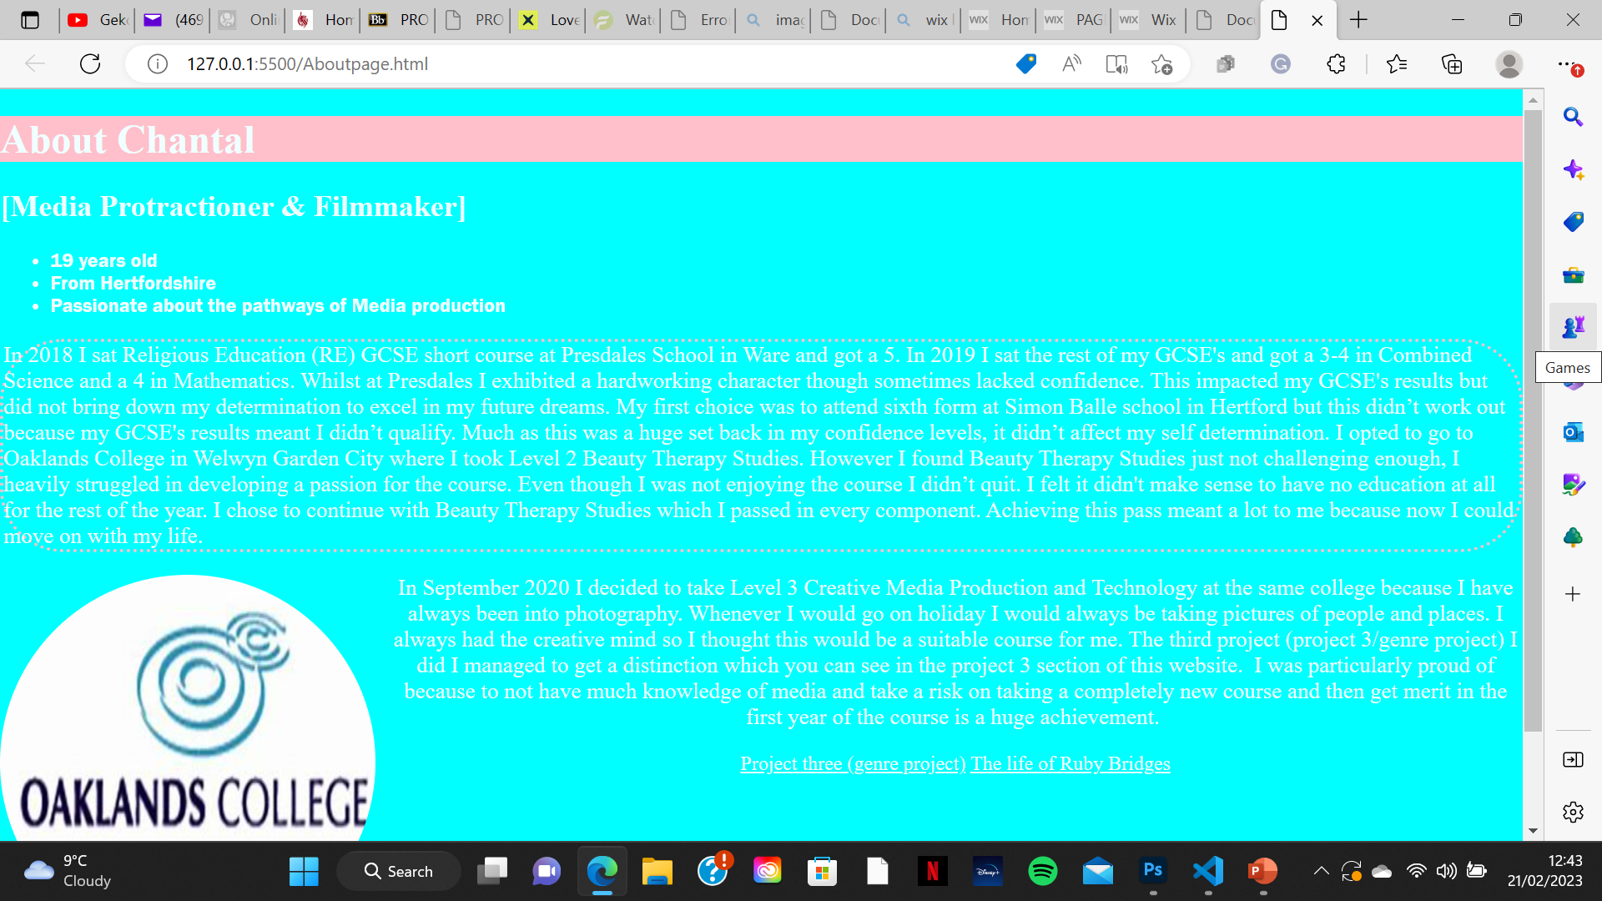
Page 1
Style attribute –
To make the background colour blue
To make the header background pink
To create the heading itself I used the <h1> and <h2> element
I made sure that the “About Chantal” heading got the <h1 element as the number represents the importance of the heading meaning h1 will be largest and boldest heading
I used the <li> element to create an ordered list –just to mention some basic facts about me

Slide 4
Page 1 continued

